Slide 1

Becoming The Invisible Hand Behind VPN
Bio group team:
Fengyuan Huang Rachel Hixson
Yiqing Wang Yixing Zhang
Zhiying Lu
Project presentation for 2020 summer cloud computing course
Aug 04, 2020

Slide 2

Main Ideas of This Project
C
user
A
Server
What is VPN?
We are anonymous
Virtual Server on cloud
B
tunnel
Why Use VPN?
For individual user
For business user
Scenario 1: Privacy and Security, in a public or unsecured network
Scenario 3 : Connect different office remotely
Scenario 2: Teleport, travel to a private internet, such UAB VPN
Our VPN-
Surfing the internet without worrying about loss of privacy
User Device
EC2 Oracle Linux
+
Pritunl + MongoDB
Internet
Public Internet
User IP
EC2 Virtual Server on AWS
EC2 Server IP
VPN
Notes:
So what is Vpn. VPN is an abbreviation for Virtual Private Network. As the name suggests it is a virtual network created over the internet/public network between two or more physical networks (or devices) to create an extended private network.
For example, if User C want to connect server A by internet, He can connect to Virtual server B first, then through B to connect A. C to B to A is a private and encrypted tunnel. For server A, he think all the request are from B. Actually, C is the real ‘black hand’ behind that. This is also where the idea of our Project title comes from.
Generally, there are three scenario that need to use VPN. For individual user, you may want to use a public WIFI, but worry the privacy and security issue; or you want to access to a private internet through public internet connection. For example, many people work at home, but the want to access the server at UAB, then he needs a UAB VPN. For business users, they may have different office located all over the world, but they want to connect all these office like it works in a private internet. Then they need a VPN.
Here, we use AWS to build a VPN to implement a function in the scenario 1. Use this VPN, user do not need to worry about the Privacy loss or security issue when use a public WIFI, because the public internet just display the IP address of EC2 Virtual Server on AWS.

Slide 3
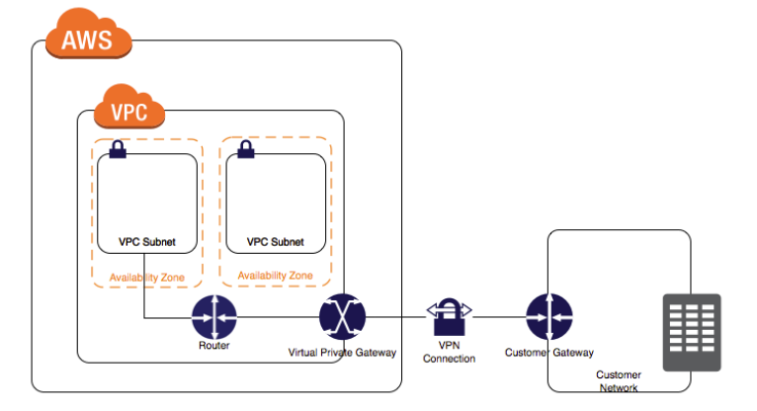
Technical Approach
General Steps to Build a VPN
1. Start EC2 Oracle Linux
3. Routing on AWS
2. Install pritunl and MangoDB
4. Mango Database Setup
5. Creating Server
6. Configuring Server
Frame of a VPN
Cite from AWS tutorial
7. Downloading User Profile
Notes:
This figure show how the VPN connection works. User is here, and Virtual server is here. Literally, these two network can not exchange information by public internet due to the gateway. VPN connect the virtual private gateway and customer gateway. To finish this process, first we need to start a C2 Oracle Linux virtual machine, and Install pritunl and MangoDB on it. Once done, routing on AWS, setup Mango Database, and create virtual server. Finally, configure server and update security group. Here, the VPN connection has established. By user profile, user can login and VPN begin to work.

Slide 4
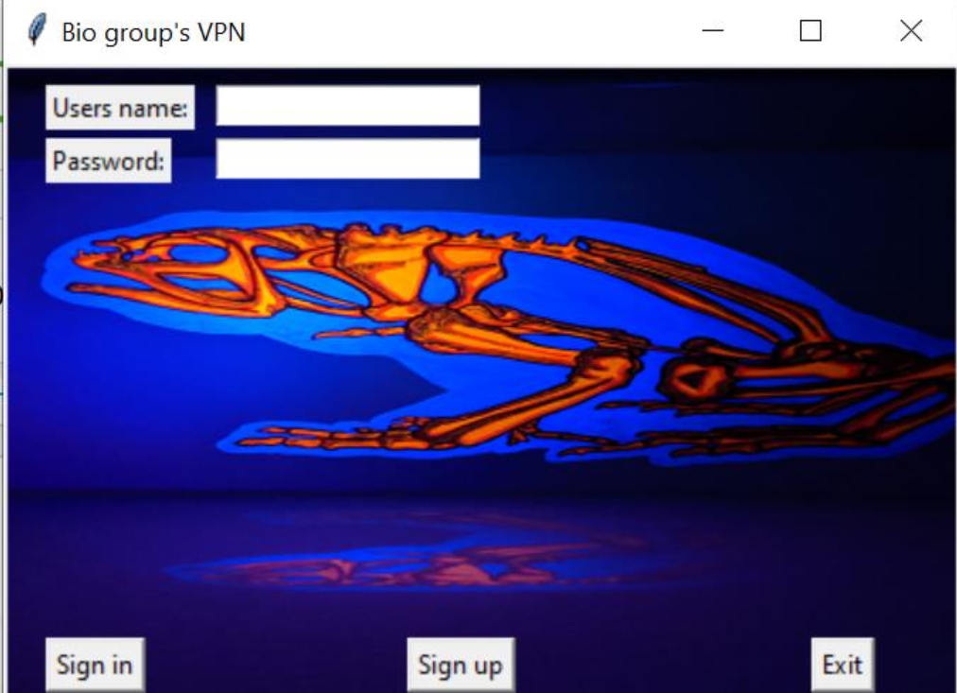
Components of our system
User End
Login Interface
Server
On AWS
Public Internet
EC2 Oracle Linux
Pritunl
Mango database
Notes:
Basically, Our system includes two major parts. The first one is login interface. We write it by tkinter model in python and run it locally. The second part is Virtual server on AWS. It contains three modules: EC2 Oracle Linux, Pritunl and Mango database.

Slide 5
Lessons We Learned
Understand how a virtual server runs on the cloud
Know the basic concepts of Computer Network Hierarchy and internet security
Learn how internet infrastructure works
Linux command and python codes
How to create a database and simple SQL

Slide 6
Discussion and Future Work
Pros & Cons
Secures the Cloud 😁
Enables Remote Access 😁
Encrypts Transmitted Data 😁
Decreased speed with AWS 😭
In a future version of the login interface, a user could choose the location of the server
Monitor and put a limit on connection time and traffic
When we run virtual server outside US, we should consider the local law and regular about data security

Slide 7
Demo for VPN

Slide 8
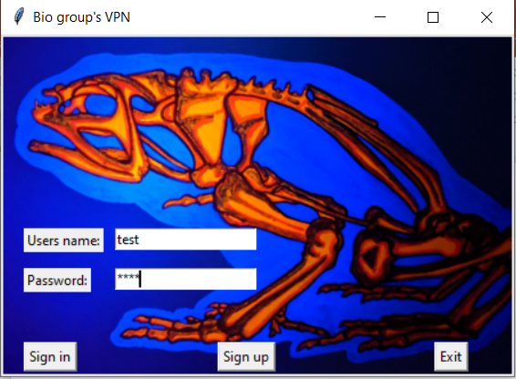
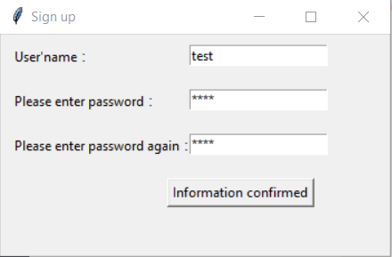
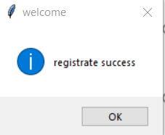
Login
Notes:
User use this interface to login the VPN connection. First sign up to create a count. Once done, login in. The traffic to Virtual server connected.

Slide 9
Two ways to show the VPN is working
1. The IP address will change after VPN connected. We use G suite, a online tool, to check IP address and position.
2. The package will send to cloud after VPN connected.(Using Wireshark)
Notes:
Two ways to show the VPN is working. The first one is to show the IP address change. The second one is to use wireshark to track where data package goes.

Slide 10
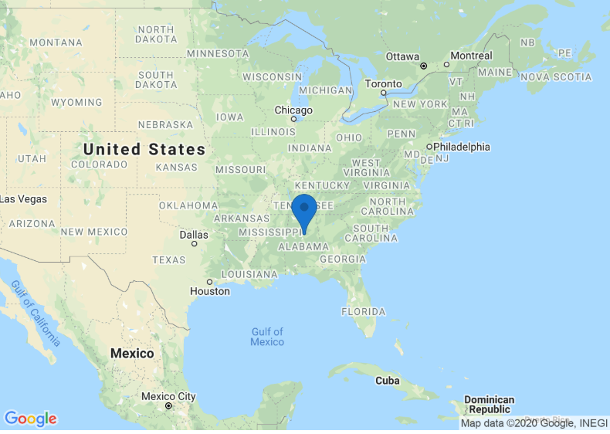
68.117.173.143
IP address Before VPN connect (by G suite tool)
(A)
Notes:
G suite tool can be used to find IP address, IP position and traceroute. Before connecting to VPN, the IP address show we are in Alabama.

Slide 11
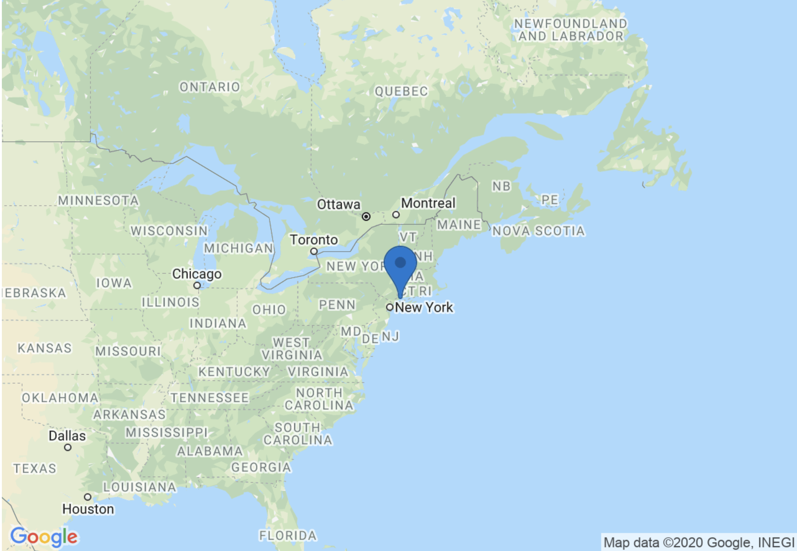
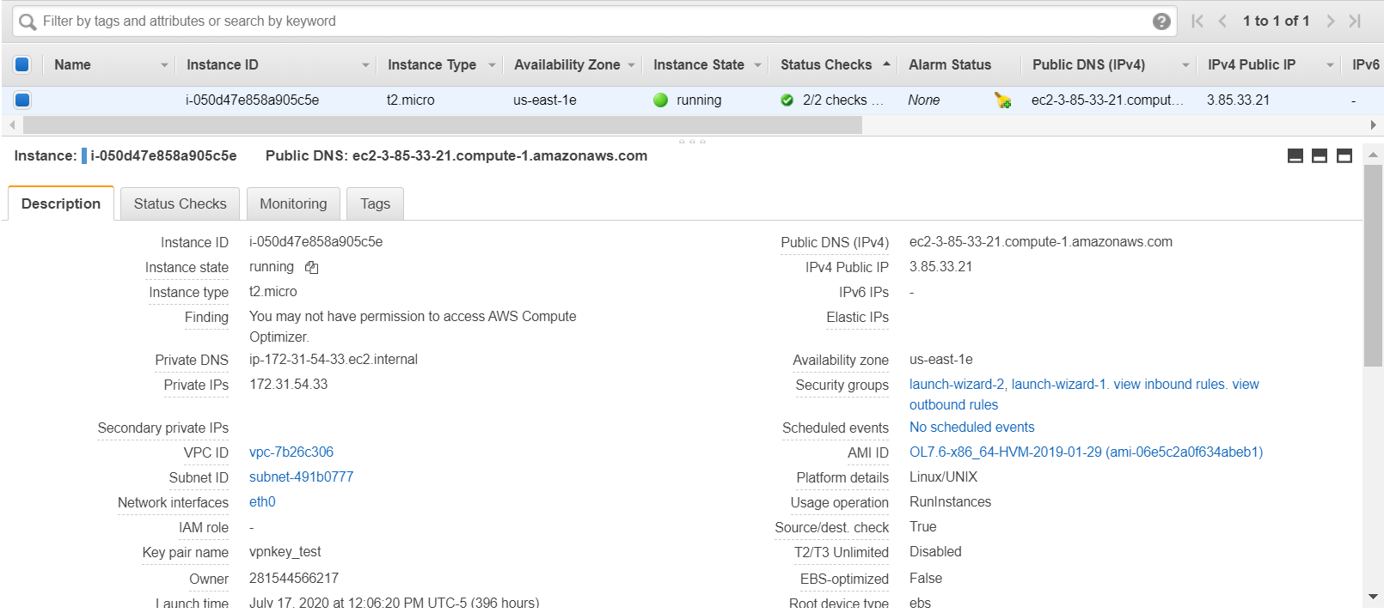
IP address after VPN connect (by G suite tool)
(B)
3.85.33.21
Notes:
When VPN connected, my current IP address show we are in the New York now. And IP address is same with our VPN server.

Slide 12
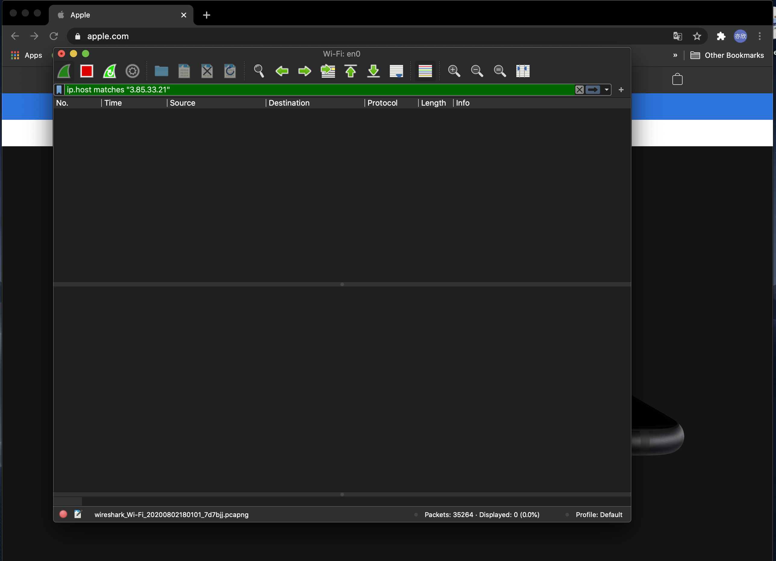
Before VPN connect
Wireshark
Cannot capture any packet send to VPN IP address. Although, the Wireshark has capture over 30000 packets.
When refresh the browser, the packet still cannot be found.
(A)
Notes:
Before VPN connects, wireshark Cannot capture any packet send to VPN virtual server IP address

Slide 13
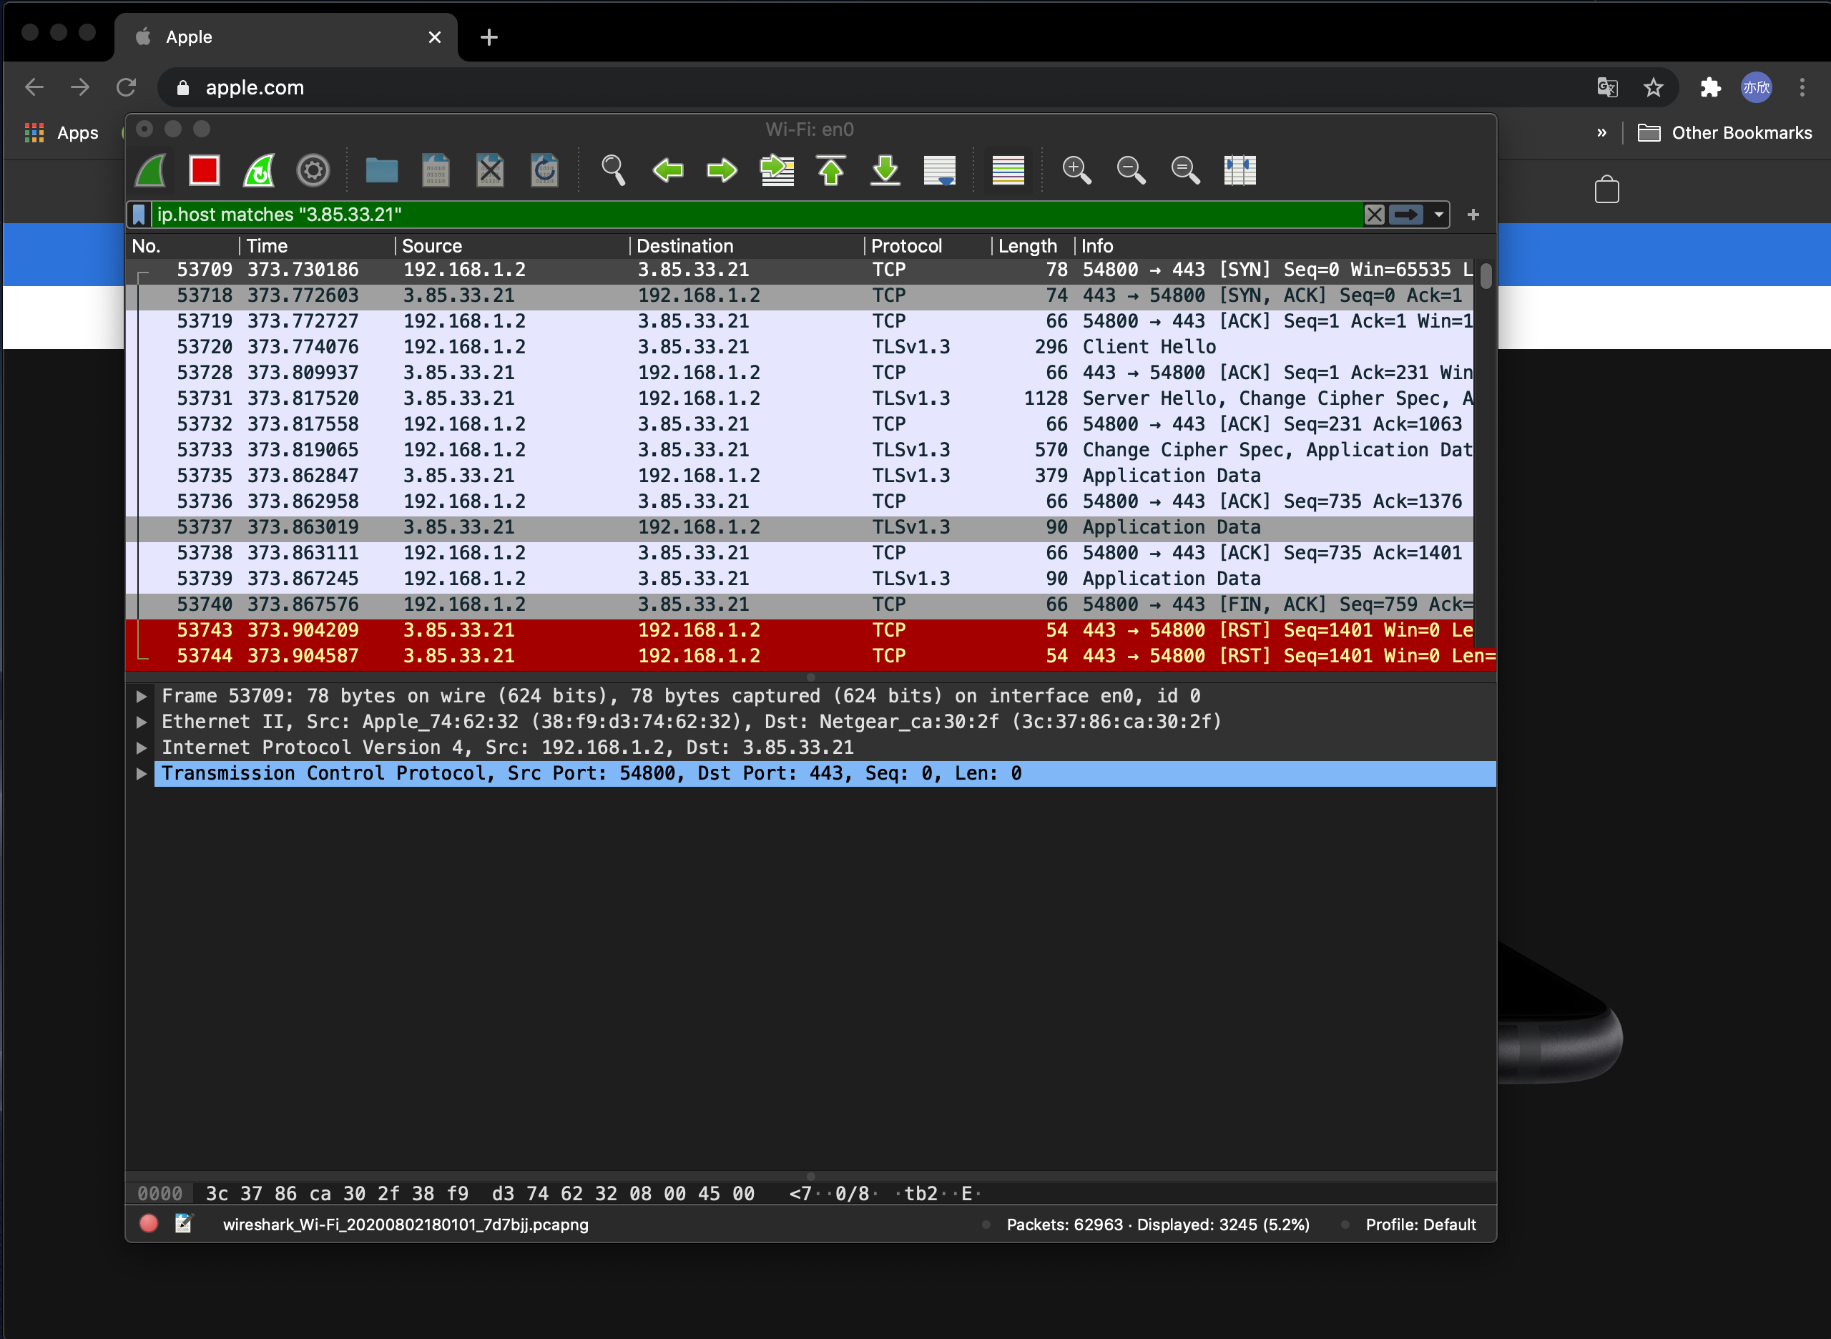
After VPN connect
When VPN established and refresh the apple.com homepage, the packet from “3.85.33.21”can be captured.
It also means the VPN connection success.
For now over 60000 packet has been captured. And 3245 (5.2%) of them related to VPN server.
(B)
Notes:
But, once the tested user connects to VPN, and the user visits the apple.com, wireshark detect packet send from VPN IP address.

Slide 14
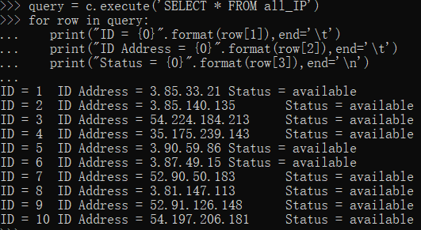
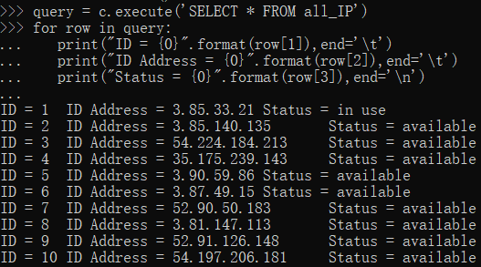
ID database
We provide users multiple IP addresses and maintain a database
Before connecting
After connecting
Users can retrieve this table and choose IP according to the ID
Notes:
In addition, We provide users multiple IP addresses and maintain a database. User can choose different server based on its geographic location. This is the current server ip address. Before connecting, its status is available. Once connecting, it shows in use.

Slide 15
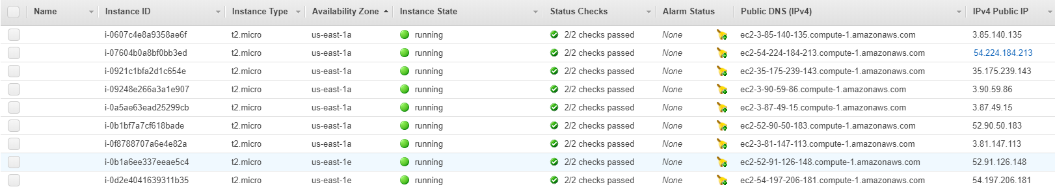
Notes:
Different virtual server on AWS

Slide 16
Task Distribution
1. Coding Interface and deploy on AWS：Yixin Zhang
2. VPN connection and Coding: Yiqing Wang, Zhiying Lu
3. Report: Rachel Hixson, Fengyuan Huang
4. Presentation: Zhiying Lu, Rachel Hixson
Supplementary:
1. Everyone contributes to the post-revision for Presentation and report
2. Everyone shared their ideas on building the VPN

